Slide 1
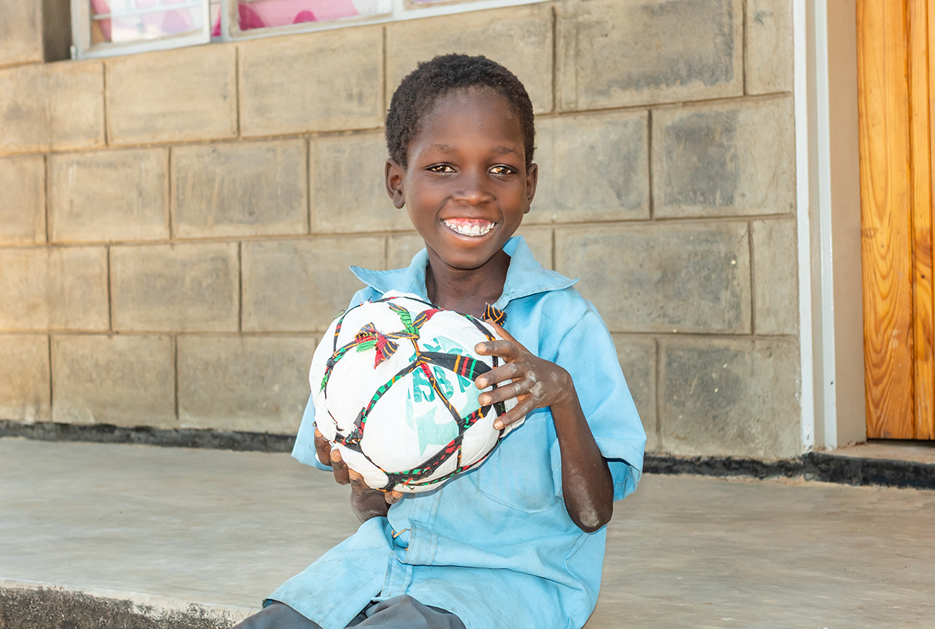


Welcome to the 2026 World Mission Mass

Slide 2



Slide 3
Acknowledgement of Country
Notes:
Use the acknowledgement from your school/area and refer to the language groups of your area.

Slide 4
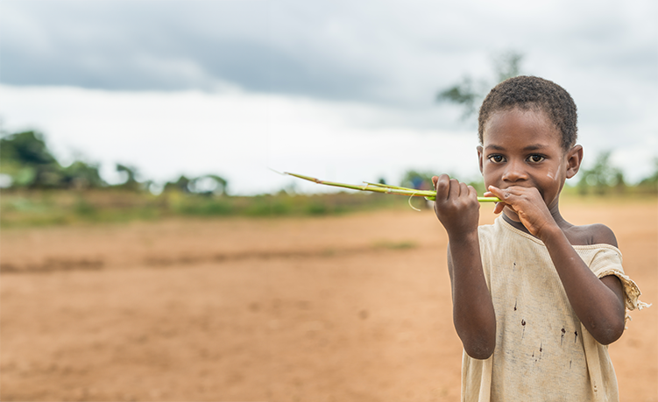
Introducing Malawi
Notes:
Speakers and carriers reverently bring the images and objects to the focus area in the front of the altar.

Slide 5
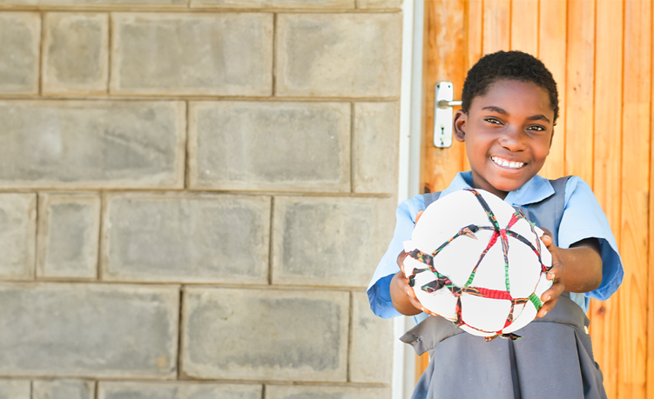
Gathering Song
Suggested for Primary Schools: Lead Me, Lord – John D Becker
Suggested for High Schools:
A Rightful Place – Steve Angrisano
Notes:
Please find the song’s resource files on ONE LICENSE, find the relevant links on our webpage.

Slide 6

Presider:
We gather ... In the name of the Father, and of the Son, and of the Holy Spirit.
All: Amen

Slide 7
Presider: Lord Jesus, you walk with all of creation, especially those have been placed at the margins and are in need.
Lord, have mercy.
All: Lord, have mercy.

Slide 8
Presider: You lift up the poor and forgotten. Christ, have mercy.
All: Christ, have mercy.

Slide 9
Presider: You call us to be bearers of hope. Lord, have mercy.
All: Lord, have mercy.

Slide 10
Presider: May our loving God, who is rich in mercy, forgive us, renew our hearts, and lead us to everlasting peace.
All: Amen.

Slide 11

Opening
Prayer
All: Amen
(Please be seated)

Slide 12
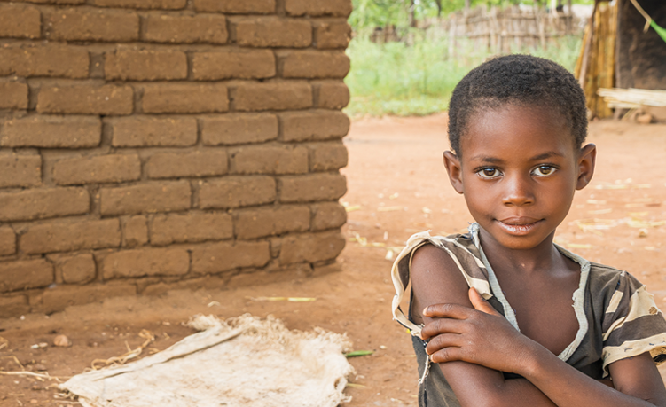

Liturgy of the word

Slide 13
A reading from
Isaiah 32: 15-18
Reply: Thanks be to God

Slide 14
R: Justice shall flourish in God’s time, and fullness of peace for ever.
Responsorial Psalm
Psalm 71:2-4, 7-8, 12-13, 17

Slide 15
Reader: May the mountains bring forth peace for the people and the hills, justice. May God defend the poor of the people and save the children of the needy.
R: Justice shall flourish in God’s time, and fullness of peace for ever.

Slide 16
Reader: In God’s days justice shall flourish and peace till the moon fails.
God shall rule from sea to sea, from the Great River to earth's bounds.
R: Justice shall flourish in God’s time, and fullness of peace for ever.

Slide 17
Reader: For God shall save the poor when they cry and the needy who are helpless. God will have pity on the weak and save the lives of the poor.
R: Justice shall flourish in God’s time, and fullness of peace for ever.

Slide 18
Reader: May God’s name be blessed for ever and endure like the sun. Every tribe shall be blessed in God, all nations bless God’s name.
R: Justice shall flourish in God’s time, and fullness of peace for ever.

Slide 19
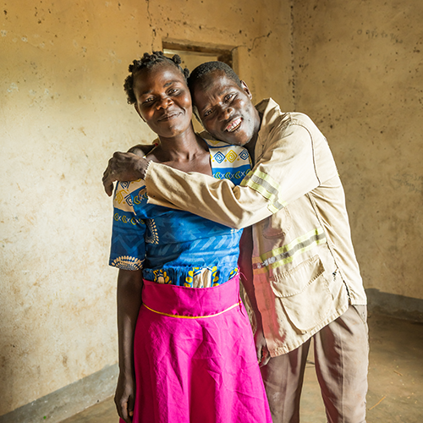
Gospel Acclamation
(Please stand)

Slide 20
Halle, Halle, Halle
Chorus by Marty Haugen

Slide 21
Gospel
A reading from the Gospel of Matthew
Sermon on the Mount
(Mt 5:1-12)
All: Praise to you, Lord Jesus Christ.

Slide 22
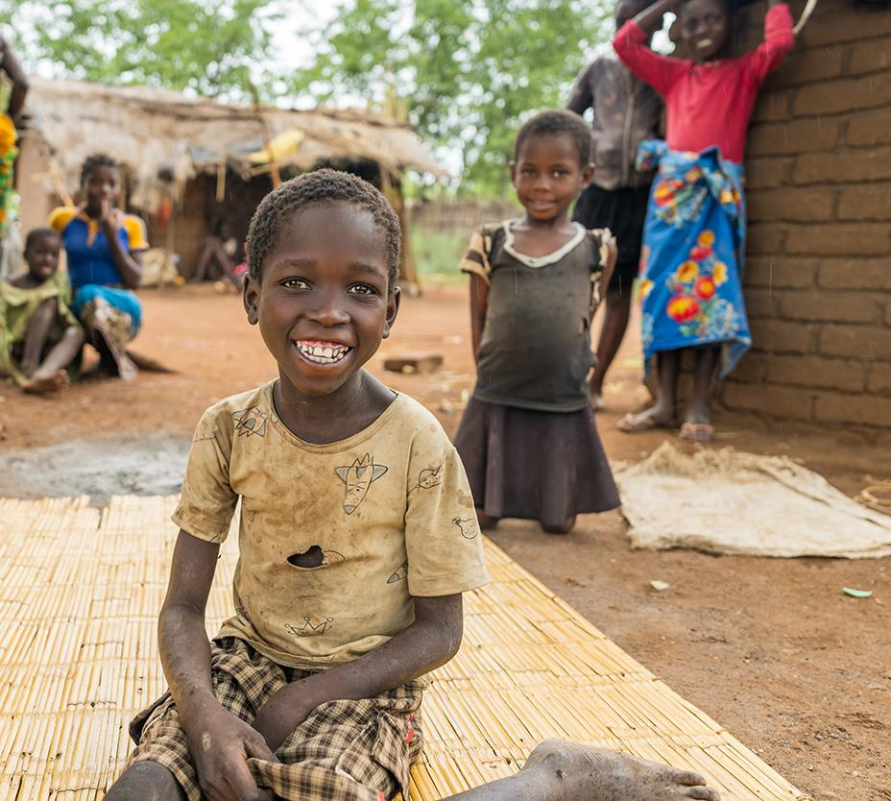
Homily

Slide 23
All: Lord Hear Our Prayer
Prayers of Intercession

Slide 24
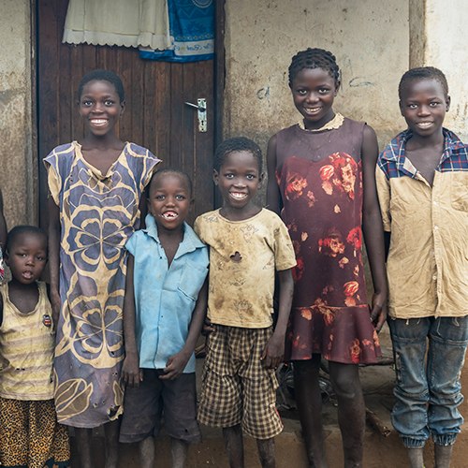
Liturgy of ​ the Eucharist​

Slide 25
Suggested song:
Table Song
By Kevin Bates

Slide 26
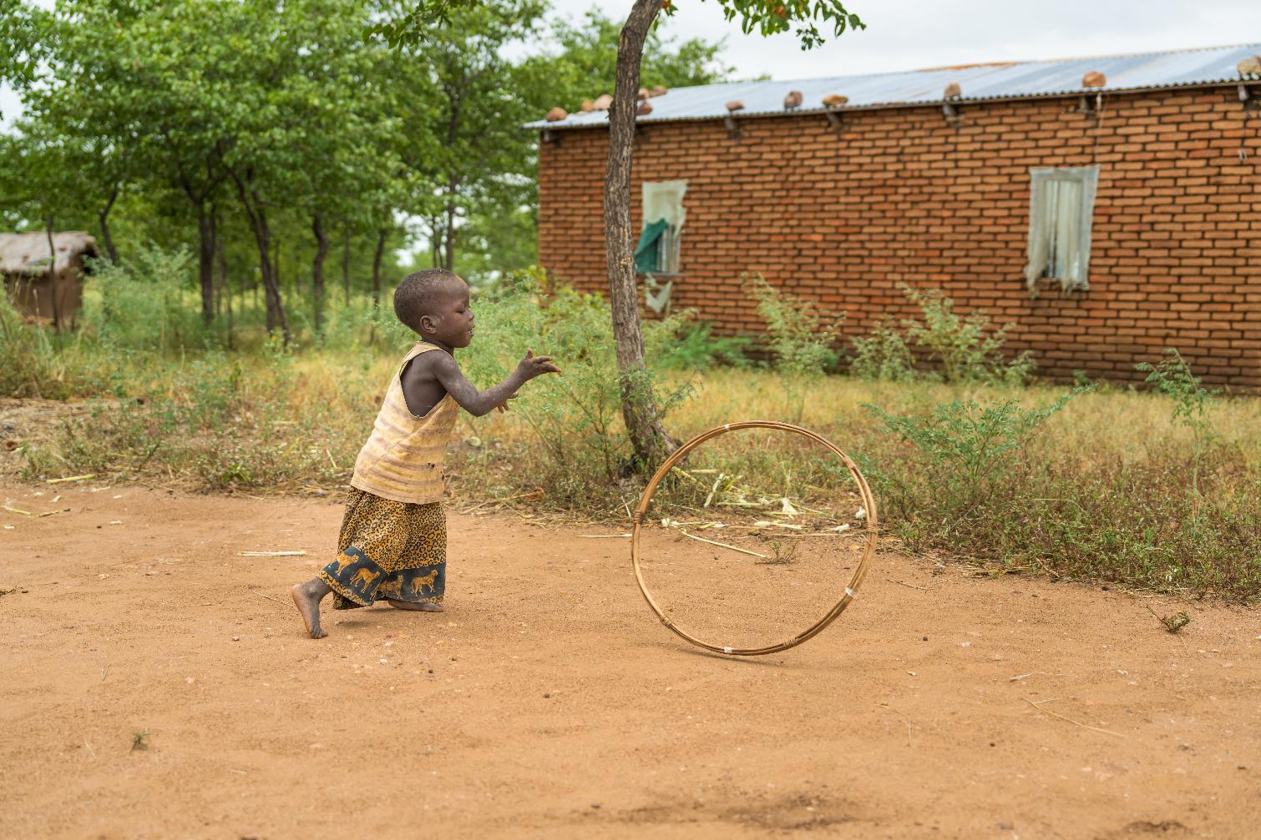
Liturgy of ​ the Eucharist​
All: Blessed be God forever

Slide 27
All:
May the Lord accept the sacrifice ​ at your hands​ for the praise and glory of his name,​ for our good and the good of all ​ his holy Church.
Prayer over the Offerings

Slide 28
Presider: Loving Creator…
All: Amen
Prayer over the Offerings

Slide 29
Presider: The Lord be with you.
All: And with your Spirit.
Eucharistic Prayer for
Children

Slide 30
Presider: Lift up your hearts.
All: We lift them up to the Lord.
Eucharistic Prayer for
Children

Slide 31
Presider: Let us give thanks to the Lord our God.
All: It is right and just. (Clap three times)
Eucharistic Prayer for
Children

Slide 32
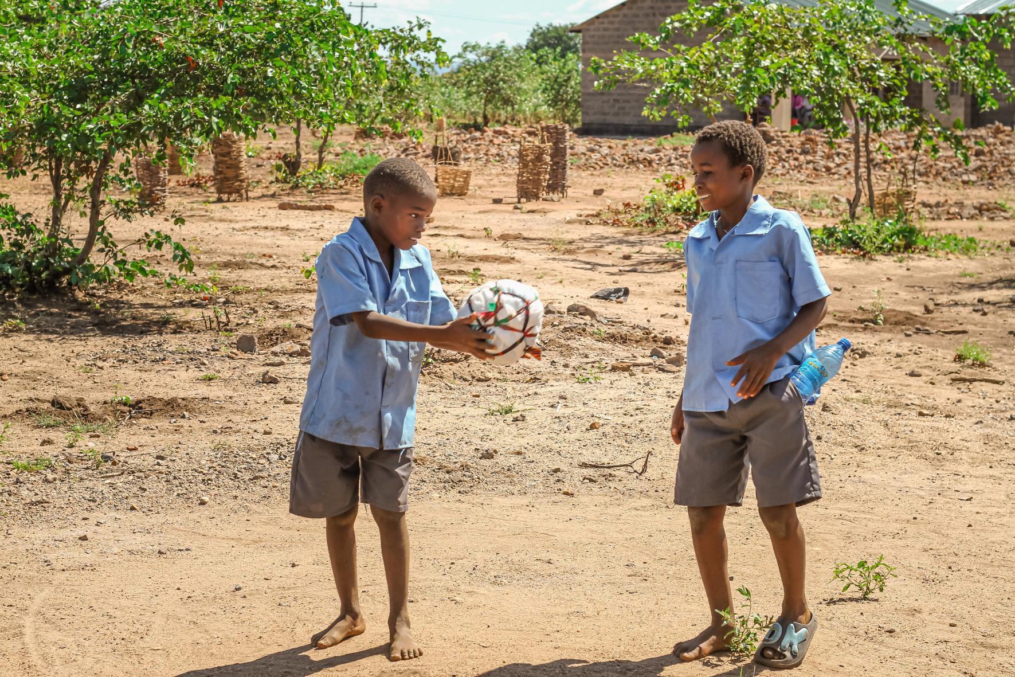
Eucharistic Prayer for
Children

Slide 33
All:​
Holy, Holy, Holy Lord, God of hosts.​
Heaven and earth are full, full of your glory.​
Hosanna in the highest. ​
Blessed is he who comes in the name of the Lord​
Hosanna in the highest.
Eucharistic Prayer for
Children

Slide 34
All:​
When we eat this bread and drink this cup​
We proclaim your death O Lord,​
Until you come again.
Eucharistic Prayer for
Children

Slide 35
Presider: Father, because you love us …
All: Amen
Eucharistic Prayer for
Children

Slide 36
Communion Rite:
The Our Father

Slide 37
All:
Our Father, who art in heaven, hallowed be thy name; thy kingdom come, thy will be done on earth as it is in heaven.
Give us this day our daily bread,
And forgive us our trespasses, as we forgive those who trespass against us; and lead us not into temptation, but deliver us from evil.

Slide 38
All:
For the kingdom,​ the power and the glory are yours​ now and for ever.

Slide 39
Presider: Lord Jesus Christ, who said to your Apostles: Peace I leave you, my peace I give you, look not on our sins but on the faith of your Church, and graciously grant her peace and unity in accordance with your will. Who live and reign for ever and ever.​
All: Amen​
Presider: The peace of the Lord be with you always.​
All: And with your spirit.​
Presider: Let us offer each other the sign of peace.
Sign of Peace

Slide 40
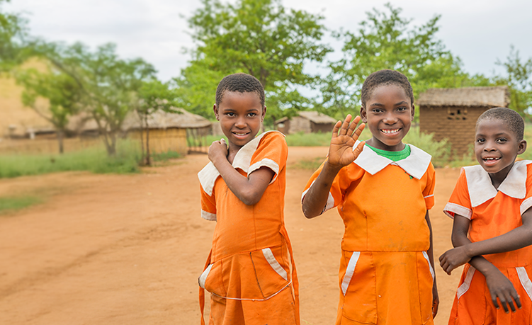
Sign of Peace

Slide 41
All:
Lamb of God, you take away ​ the sins of the world,​ have mercy on us.​
Lamb of God, you take away ​ the sins of the world,​ have mercy on us.​
Lamb of God, you take away ​ the sins of the world,​ grant us peace.

Slide 42
All:
Lord, I am not worthy​ that you should enter under my roof,​ but only say the word ​ and my soul shall be healed.

Slide 43
Communion Song
Suggested song: Bigger Table
By Matt Maher

Slide 44
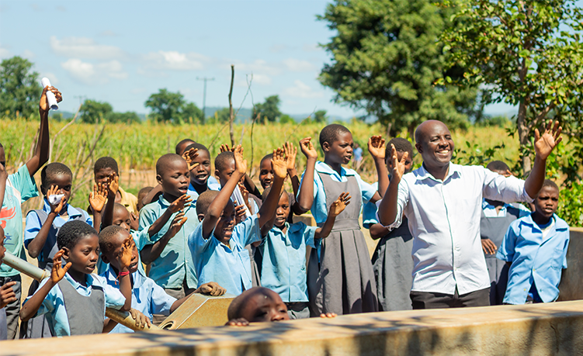
Prayer after Communion

Slide 45
Presider: Let us pray …
Through Christ our Lord
All: Amen
Prayer after Communion

Slide 46
Presider: The Lord be with you.
All: And with your spirit.
Concluding Rites

Slide 47
Presider: Bow your heads and pray for Christ’s blessing. In Christ …
All: Amen.
Concluding Rites

Slide 48
Presider: The Lord Jesus promised to be with his Church …
All: Amen.
Concluding Rites

Slide 49
Presider: May the Spirit of the Lord be with you …
All: Amen.
Concluding Rites

Slide 50
Presider: O God, you send us out as messengers of joy, peace and justice …
All: Amen.
Dismissal

Slide 51
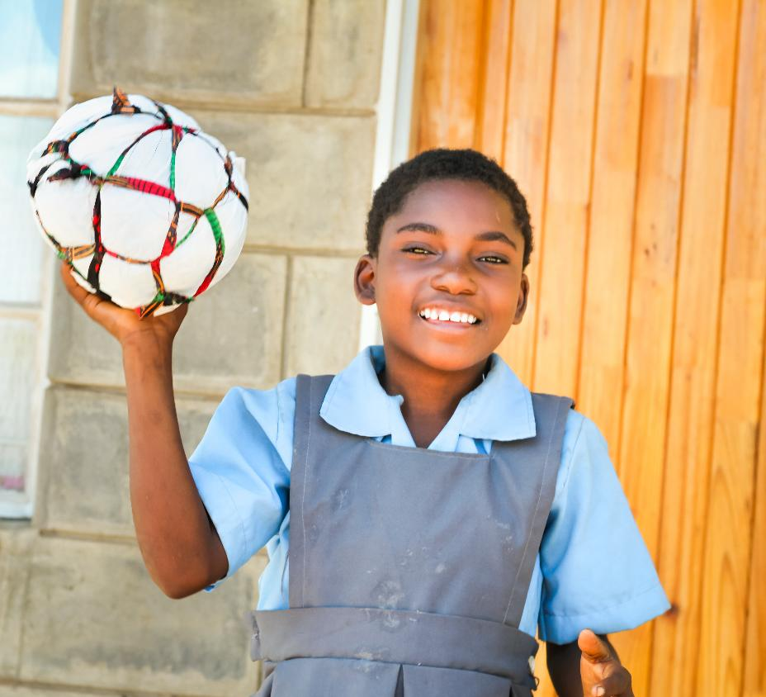
Recessional
Hymn
Suggested for Primary Schools:
Hearts on Fire - Michael Mangan
Suggested for High Schools:
Go out, Go Out - Curtis Stephan

