Slide 1




Slide 2
Acknowledgement of Country
Notes:
Use the acknowledgement from your school/area and refer to the language groups of your area.

Slide 3
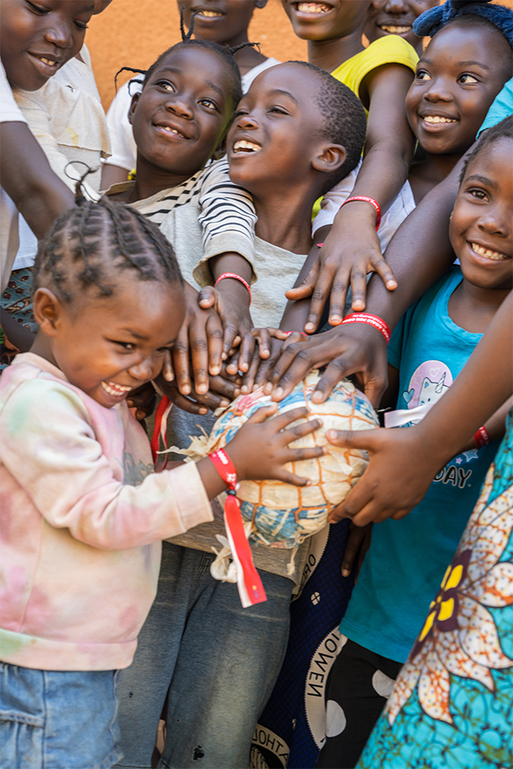
Introducing Zambia
Notes:
Speakers and carriers reverently bring the images and objects to the focus area in the front of the altar.

Slide 4
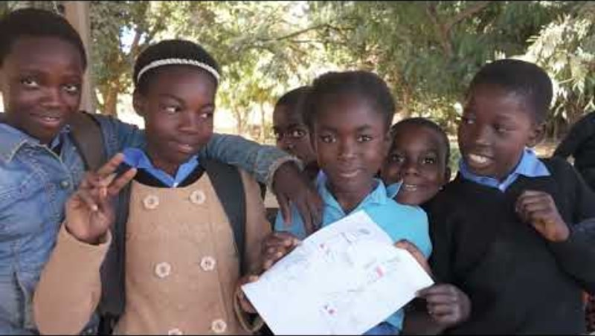

Slide 5
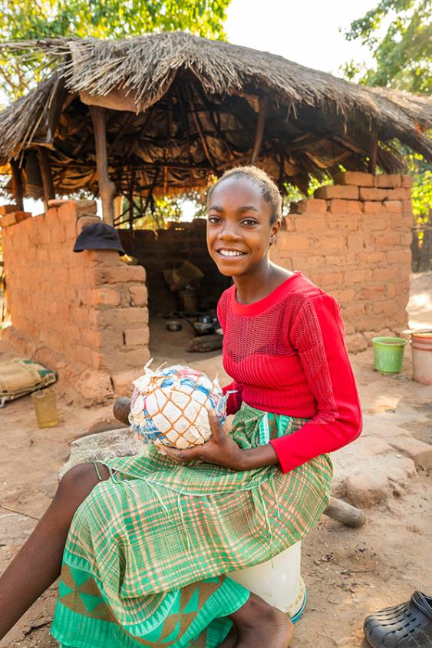

Gathering Song
Suggested for Primary Schools: Pilgrims of Hope – Andrew Chinn
Suggested for High Schools:
A Rightful Place –
Steve Angrisano
Notes:
Please find the song’s resource files on ONE LICENSE, find the relevant links on our webpage.

Slide 6
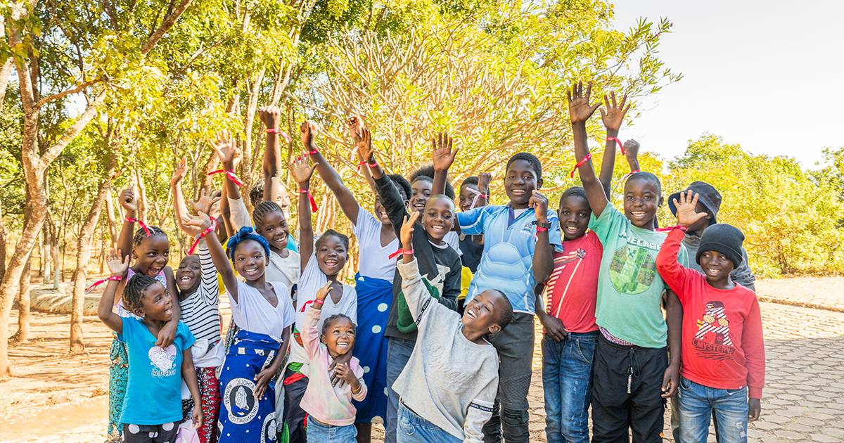
Welcome
2025 Mission Mass

Slide 7
Presider: Lord Jesus, you walk with all of creation, especially people who are living on the margins. Lord, have mercy.
All: Lord, have mercy.

Slide 8
Presider: You lift up the people who are poor and forgotten. Christ, have mercy.
All: Christ, have mercy.

Slide 9
Presider: You call us to be bearers of hope. Lord, have mercy.
All: Lord, have mercy.

Slide 10
Presider: May loving God, who is rich in mercy, forgive us, renew our hearts, and lead us to everlasting peace.
All: Amen.

Slide 11

Opening Prayer
All: Amen

Slide 12
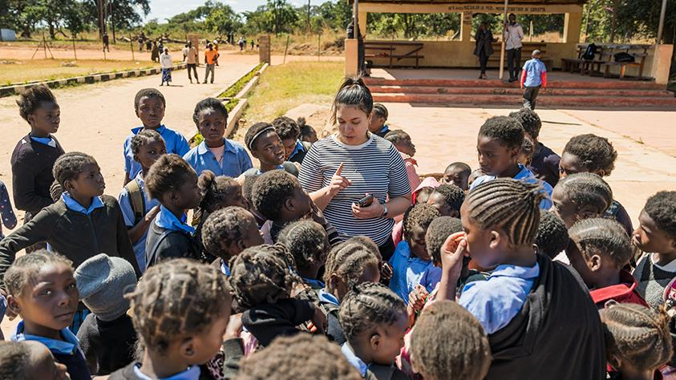
Liturgy of the word

Slide 13
A reading from
Isaiah 58: 6-9a
Reply: Thanks be to God

Slide 14
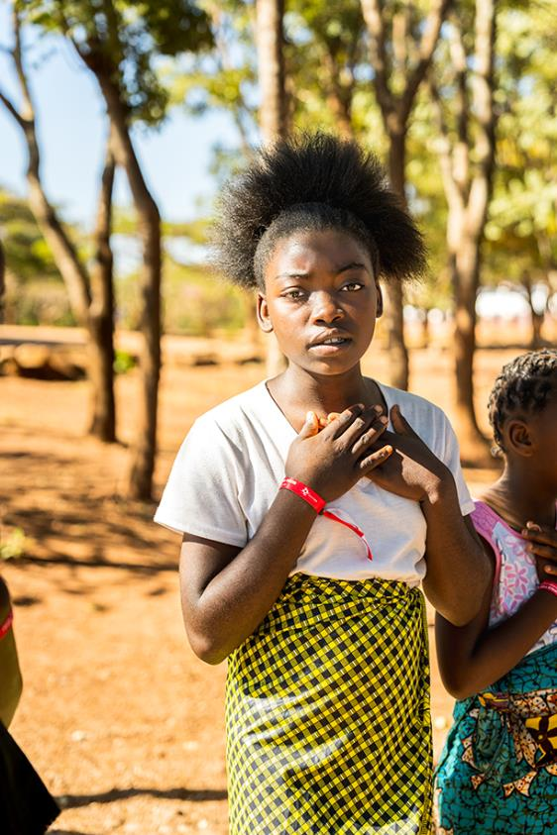
R: The Lord hears the cry of the poor.
Responsorial Psalm
Psalm 85:10-13 NRSV

Slide 15
Reader: Steadfast love and faithfulness will meet;
righteousness and peace will kiss each other.
R: The Lord hears the cry of the poor.

Slide 16
Reader:
Faithfulness will spring up from the ground, and righteousness will look down from the sky.
R: The Lord hears the cry of the poor.

Slide 17
Reader: The Lord will give what is good,
and our land will yield its increase.
R: The Lord hears the cry of the poor.

Slide 18
Reader: Righteousness will go before him,
and will make a path for his steps.
R: The Lord hears the cry of the poor.

Slide 19
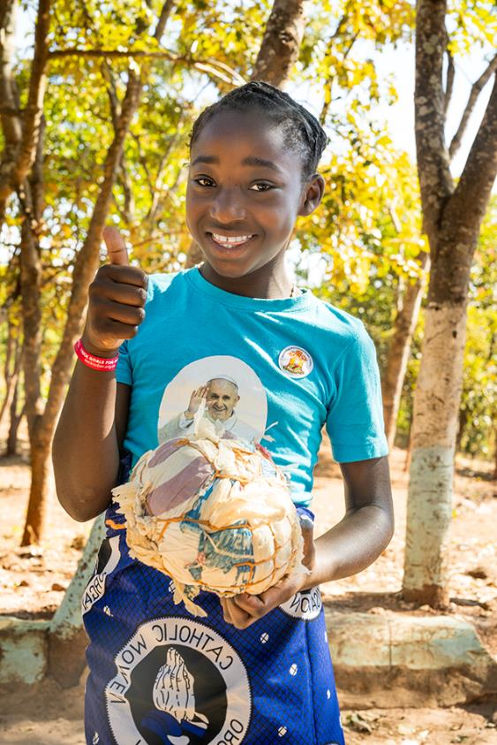
Gospel Acclamation

Slide 20
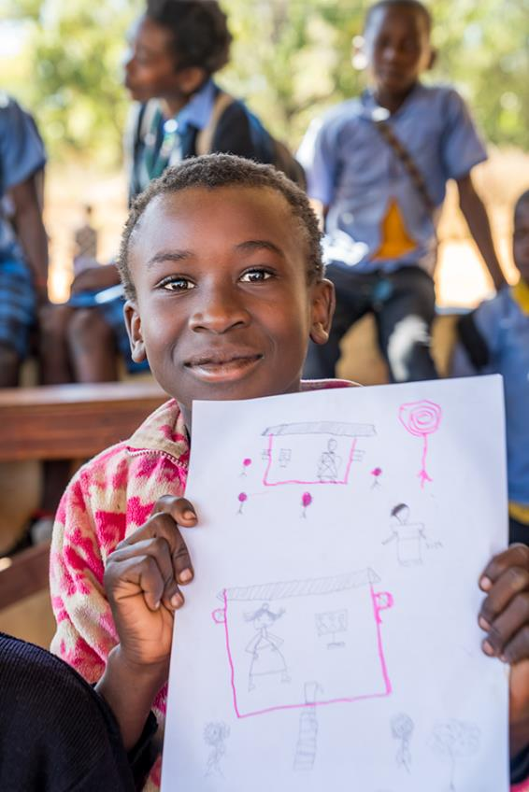
Halle, Halle, Halle
Chorus by Marty Haugen

Slide 21
Gospel
A reading from the Gospel of Matthew
Sermon on the Mount
(Mt 5:1-12)
Reply: Praise to you, Lord Jesus Christ.

Slide 22
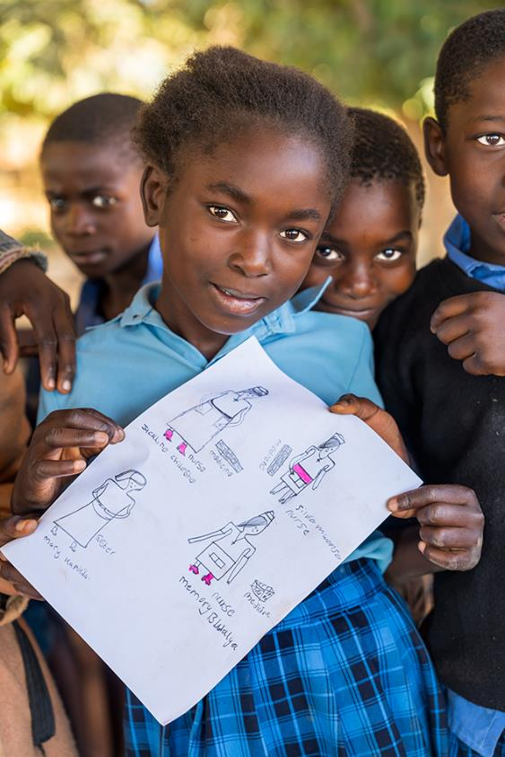
Reflection of Gospel

Slide 23
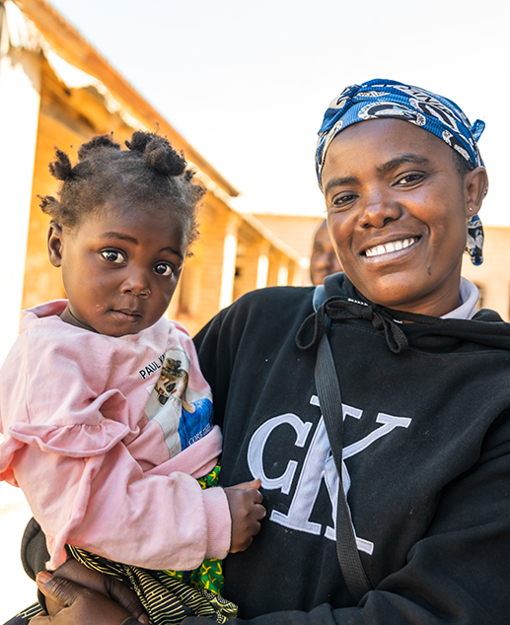
Thy word is a lamp unto my feet and a light unto my path.
Lyric by Amy Grant

Slide 24
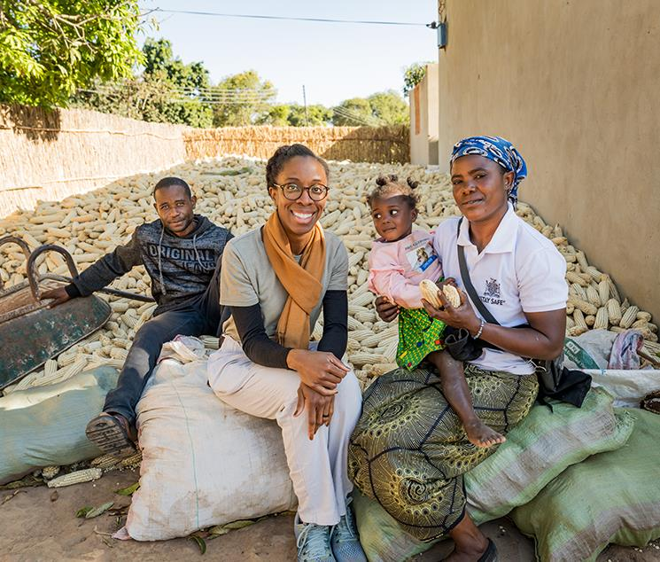
Homily

Slide 25
All: Lord Hear Our Prayer
Prayers of Intercession

Slide 26
Suggested: Ready the Way – Curtis Stephan
Reflection song

Slide 27
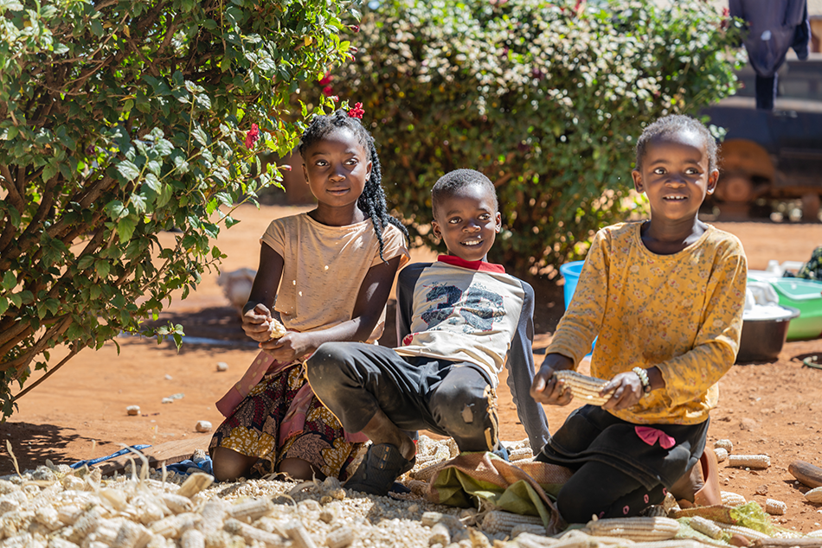
Universal
Prayer

Slide 28
All:
Our Father, who art in heaven, hallowed be thy name; thy kingdom come, thy will be done on earth as it is in heaven.
Give us this day our daily bread,
And forgive us our trespasses, as we forgive those who trespass against us; and lead us not into temptation, but deliver us from evil.

Slide 29
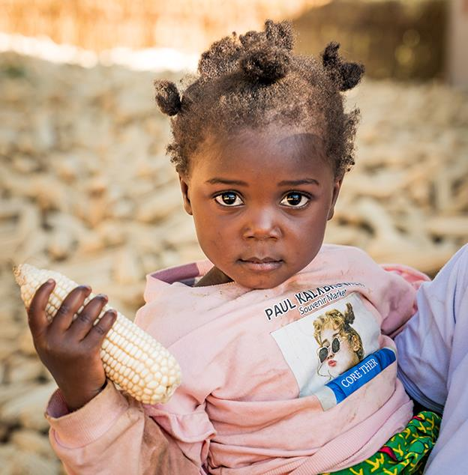
Concluding Rite

Slide 30
Recessional Hymn
Suggested for Primary Schools: Hearts on Fire- Michael Mangan
Suggested for High Schools:
Go out, Go Out - Curtis Stephan

