Slide 1
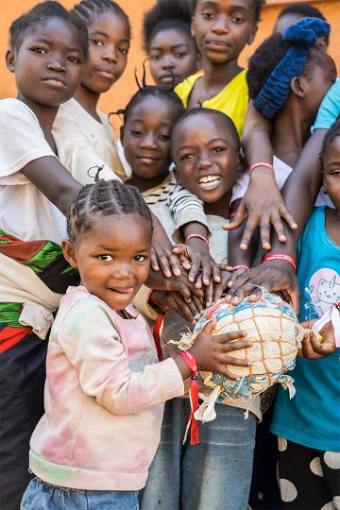



Slide 2
Acknowledgement of Country
Notes:
Use the acknowledgement from your school/area and refer to the language groups of your area.

Slide 3
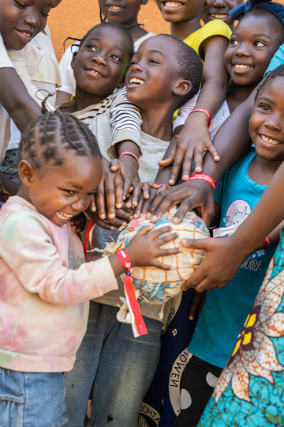
Introducing Zambia
Notes:
Speakers and carriers reverently bring the images and objects to the focus area in the front of the altar.

Slide 4
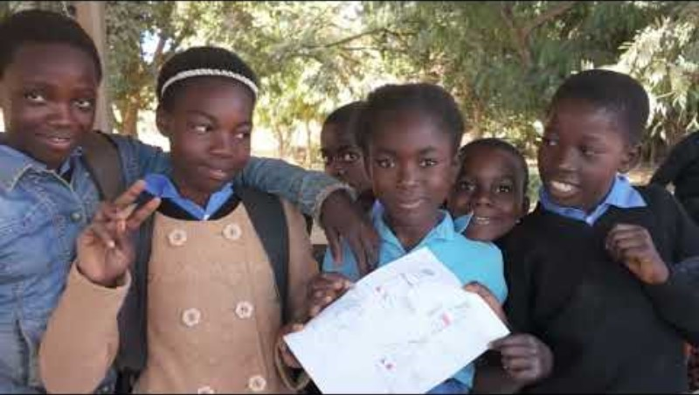

Slide 5
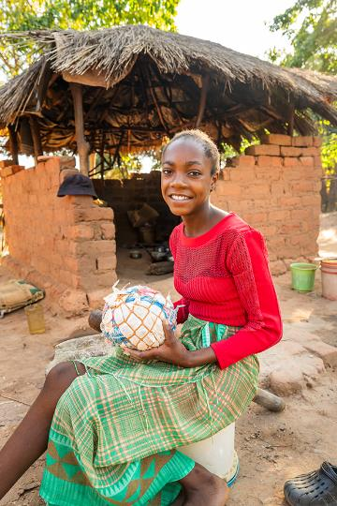

Gathering Song
Suggested for Primary Schools: Pilgrims of Hope – Andrew Chinn
Suggested for High Schools:
A Rightful Place – Steve Angrisano
Notes:
Please find the song’s resource files on ONE LICENSE, find the relevant links on our webpage.

Slide 6
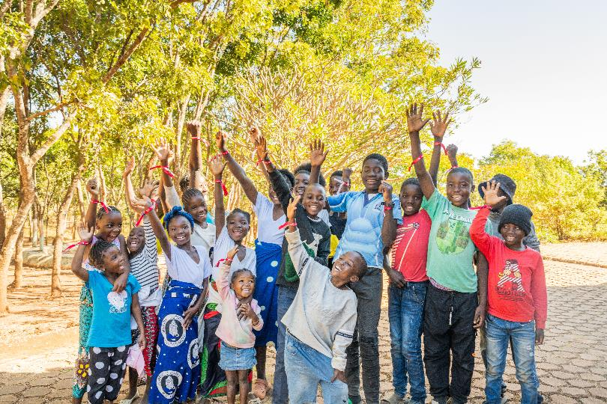
Welcome
2025 Mission Mass

Slide 7
Presider: Brothers and sisters, let us acknowledge our sins and so prepare ourselves to celebrate the sacred mysteries. You were sent to heal the contrite of heart. Lord, have mercy.
All: Lord, have mercy.

Slide 8
Presider: You came to call sinners. Christ, have mercy.
All: Christ, have mercy.

Slide 9
Presider: You are seated at the right hand of the Father to intercede for us. Lord, have mercy
All: Lord, have mercy.

Slide 10
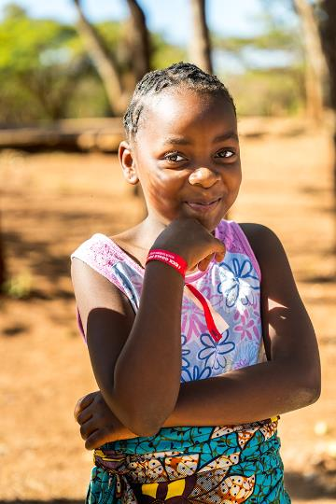
Opening Prayer
All: Amen

Slide 11
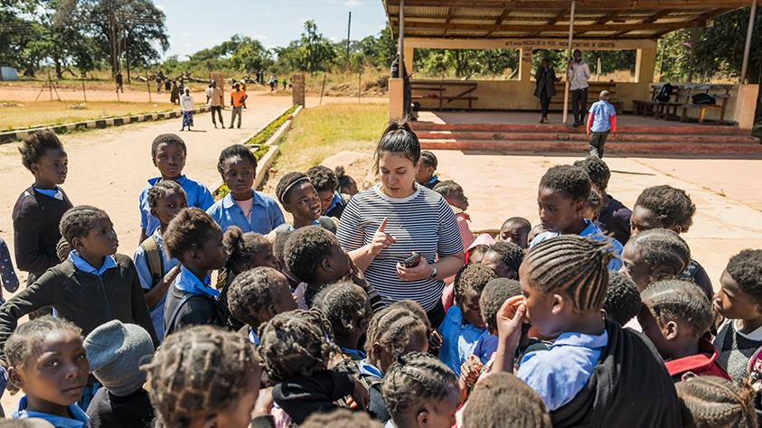
Liturgy of the word

Slide 12
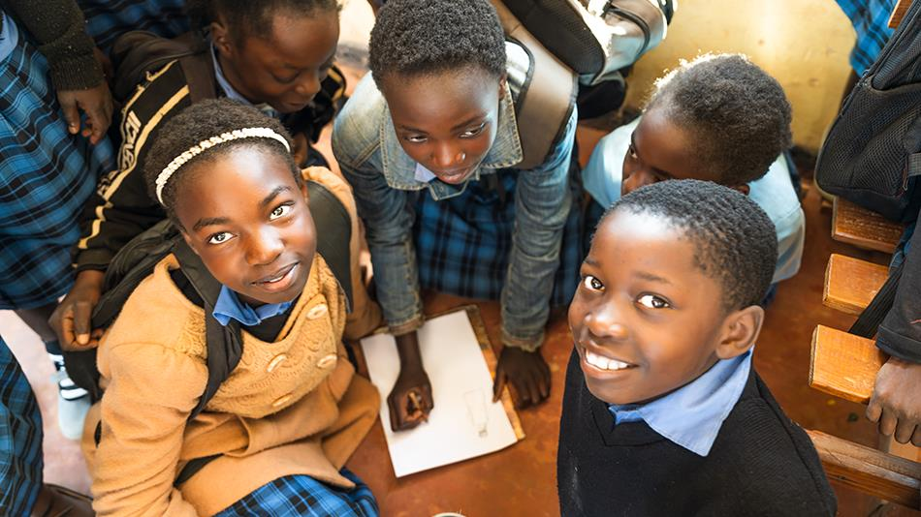
A reading from
Isaiah 58: 6-9a
Reply: Thanks be to God

Slide 13
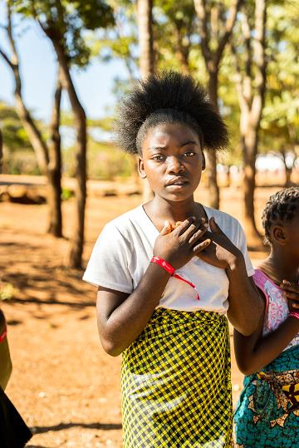
R: The Lord hears the cry of the poor.
Responsorial Psalm
Psalm 85:10-13 NRSV

Slide 14
Reader: Steadfast love and faithfulness will meet;
righteousness and peace will kiss each other.
R: The Lord hears the cry of the poor.

Slide 15
Reader:
Faithfulness will spring up from the ground, and righteousness will look down from the sky.
R: The Lord hears the cry of the poor.

Slide 16
Reader: The Lord will give what is good,
and our land will yield its increase.
R: The Lord hears the cry of the poor.

Slide 17
Reader: Righteousness will go before him,
and will make a path for his steps.
R: The Lord hears the cry of the poor.

Slide 18
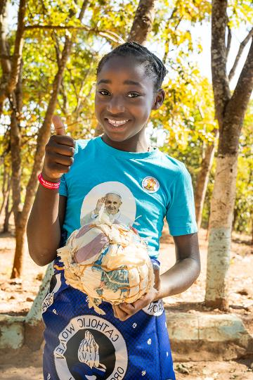
Gospel Acclamation

Slide 19
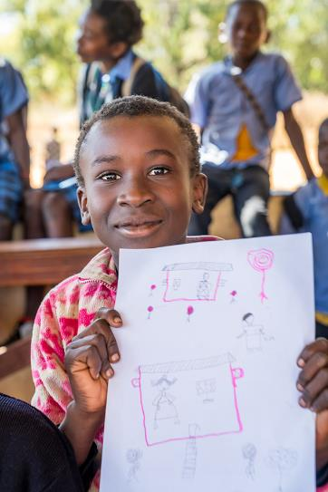
Halle, Halle, Halle
Chorus by Marty Haugen

Slide 20
Gospel
A reading from the Gospel of Matthew
Sermon on the Mount
(Mt 5:1-12)
Reply: Praise to you, Lord Jesus Christ.

Slide 21
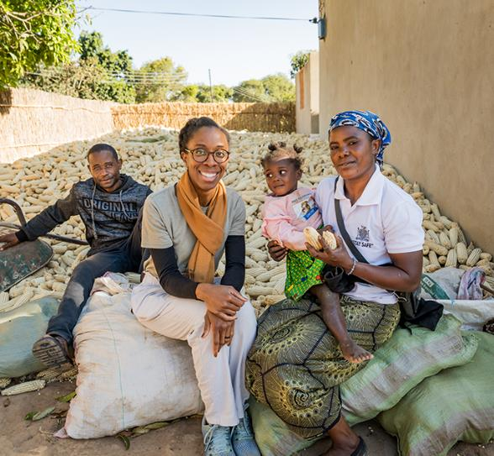
Homily

Slide 22
All: Lord Hear Our Prayer
Prayers of Intercession

Slide 23
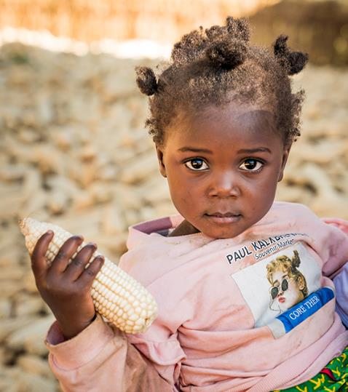
Liturgy of ​ the Eucharist​

Slide 24
Suggested song:
Table Song
By Kevin Bates

Slide 25
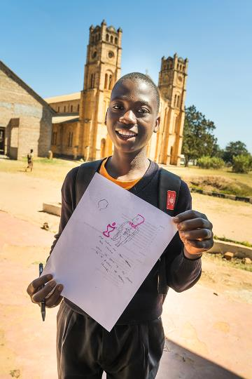
Prayer over ​ the Offerings

Slide 26
All:
May the Lord accept the sacrifice ​ at your hands​ for the praise and glory of his name,​ for our good and the good of all ​ his holy Church.

Slide 27
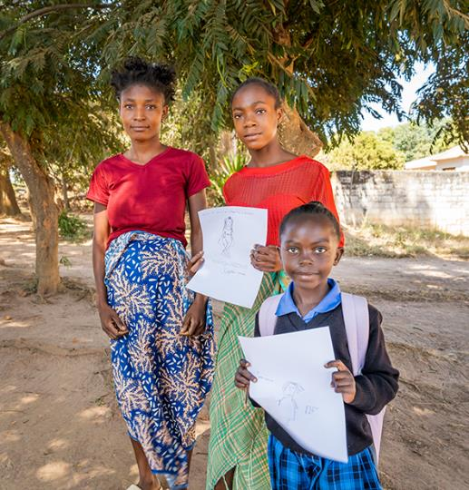
Eucharistic ​
Prayer for ​
Children

Slide 28
All:​
Holy, Holy, Holy Lord, God of hosts.​
Heaven and earth are full, full of your glory.​
Hosanna in the highest. ​
Blessed is he who comes in the name of the Lord​
Hosanna in the highest.

Slide 29
All:​
When we eat this bread and drink this cup​
We proclaim your death O Lord,​
Until you come again.

Slide 30
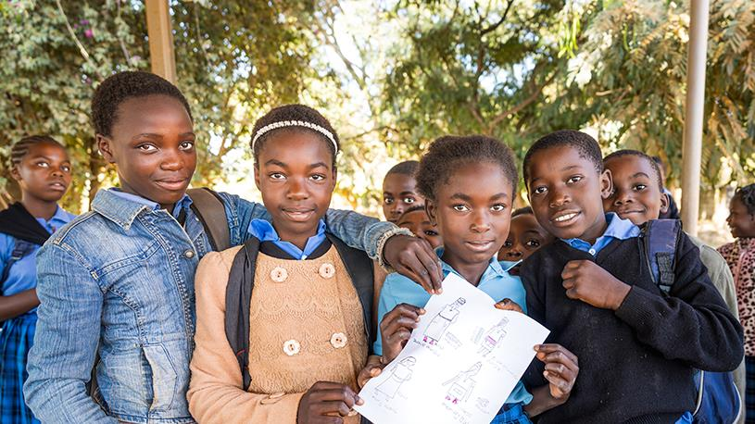
Communion​
Rite

Slide 31
All:
Our Father, who art in heaven,​ hallowed be thy name;​ thy kingdom come,​ thy will be done​ on earth as it is in heaven.​
Give us this day our daily bread,​
And forgive us our trespasses,​ as we forgive those who trespass against us;​ and lead us not into temptation,​ but deliver us from evil.

Slide 32
All:
For the kingdom,​ the power and the glory are yours​ now and for ever.

Slide 33
Presider: Lord Jesus Christ, who said to your Apostles: peace I leave you, my peace I give you, look not on our sins but on the faith of your Church, and graciously grant her peace and unity in accordance with your will. Who live and reign for ever and ever.​
All: Amen​
Presider: The peace of the Lord be with you always.​
All: And with your spirit.​
Presider: Let us offer each other the sign of peace.
Sign of Peace

Slide 34
All:
Lamb of God, you take away ​ the sins of the world,​ have mercy on us.​
Lamb of God, you take away ​ the sins of the world,​ have mercy on us.​
Lamb of God, you take away ​ the sins of the world,​ grant us peace.

Slide 35
All:
Lord, I am not worthy​ that you should enter under my roof,​ but only say the word ​ and my soul shall be healed.

Slide 36
Communion Song
Suggested song: Bigger Table
By Matt Maher

Slide 37
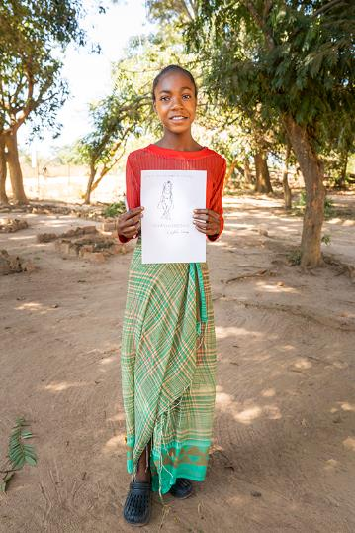
Prayer after Communion

Slide 38
Presider: Let us pray​
Pause for silent prayer​
Lord, make us holy by the Eucharist we share at your table. Through the sacrament of Your Church may all peoples receive the salvation Your Son bought us through His suffering and death on the cross, for He is Lord forever and ever.​
All: Amen.

Slide 39
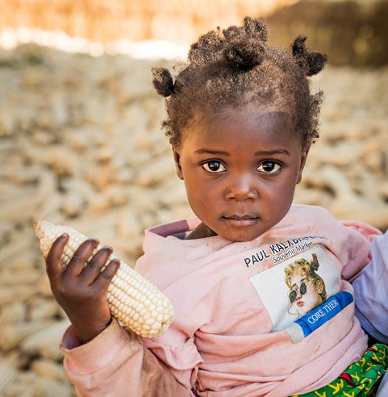
Concluding Rite

Slide 40
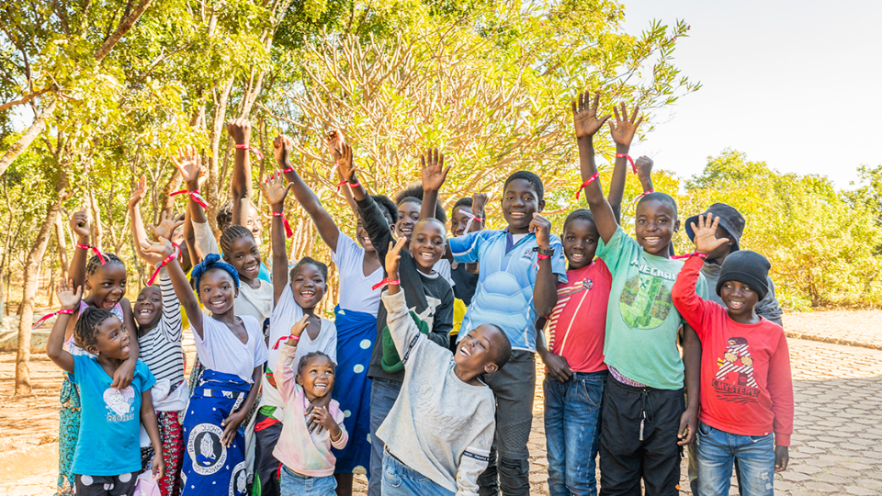
Recessional Hymn
Suggested for Primary Schools: Hearts on Fire- Michael Mangan
Suggested for High Schools:
Go out, Go Out - Curtis Stephan

