Slide 1

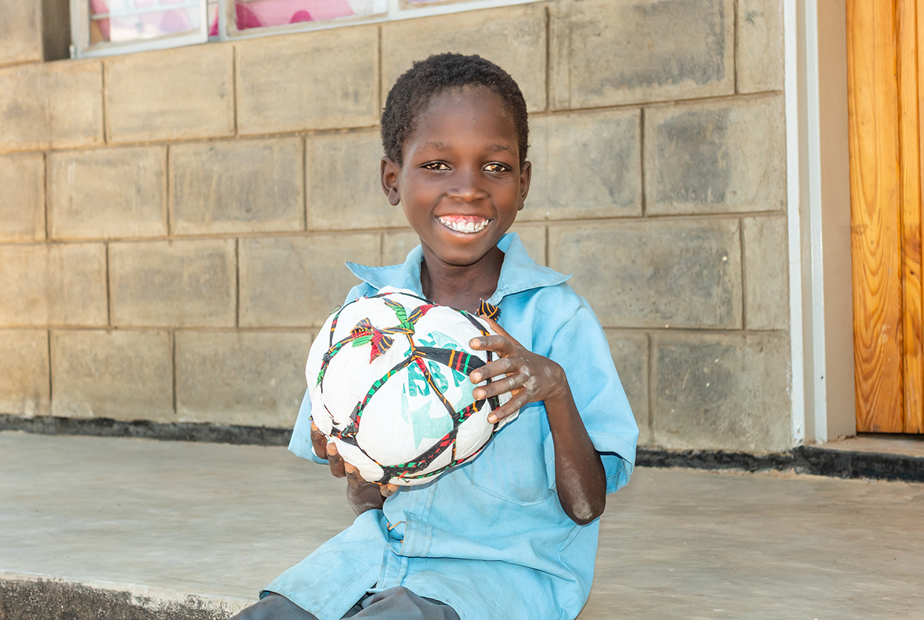

Welcome to the 2026 World Mission Mass
```

Slide 2


Slide 3
Acknowledgement of Country
Notes:
Use the acknowledgement from your school/area and refer to the language groups of your area.

Slide 4
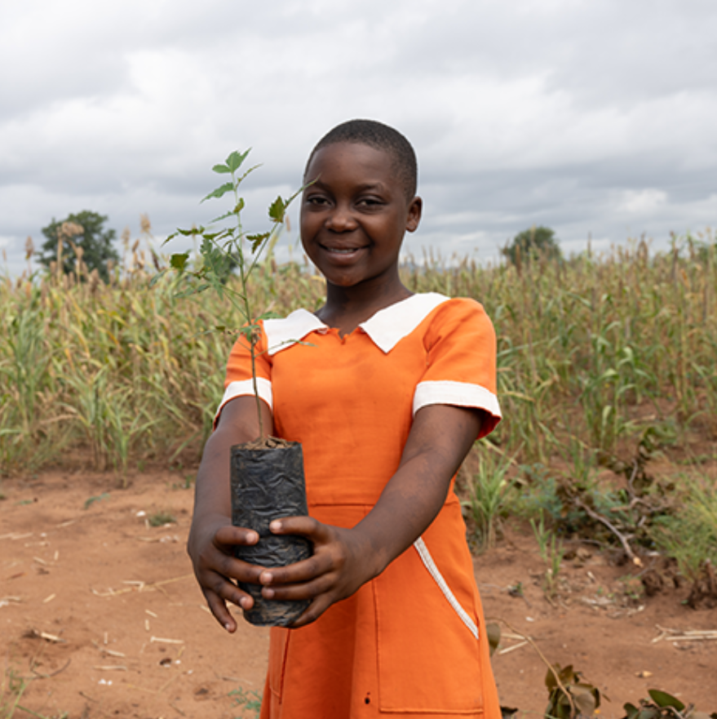
Introducing Malawi & Welcome
2026 Mission Mass

Slide 5

Gathering Song
Suggested for Primary Schools: Lead Me, Lord – John D Becker
Suggested for High Schools:
A Rightful Place – Steve Angrisano
Notes:
Please find the song’s resource files on ONE LICENSE, find the relevant links on our webpage.

Slide 6

Presider:
We gather ... In the name of the Father, and of the Son, and of the Holy Spirit.
All: Amen

Slide 7
Presider: Lord Jesus, you walk with all of creation, especially those have been placed at the margins and are in need.
Lord, have mercy.
All: Lord, have mercy.

Slide 8
Presider: You lift up the poor and forgotten. Christ, have mercy.
All: Christ, have mercy.

Slide 9
Presider: You call us to be bearers of hope. Lord, have mercy.
All: Lord, have mercy.

Slide 10
Presider: May our loving God, who is rich in mercy, forgive us, renew our hearts, and lead us to everlasting peace.
All: Amen.

Slide 11
Opening Prayer
All: Amen

Slide 12
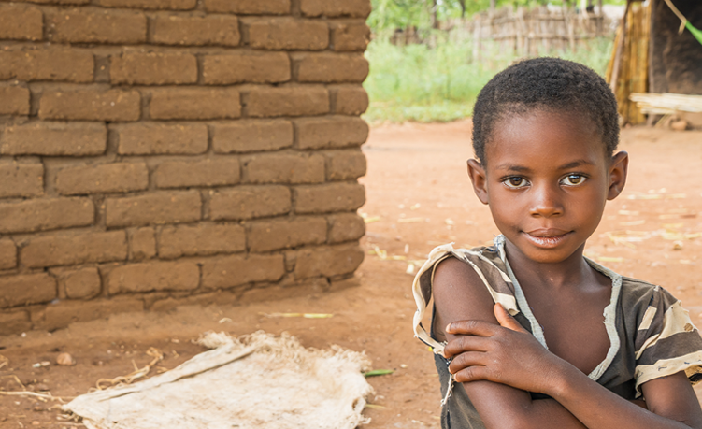

Liturgy of the word

Slide 13
A reading from
Isaiah 32: 15-18
Reply: Thanks be to God

Slide 14
R: Justice shall flourish in God’s time, and fullness of peace for ever.
Responsorial Psalm
Psalm 71:2-4, 7-8, 12-13, 17

Slide 15
Reader: May the mountains bring forth peace for the people and the hills, justice. May God defend the poor of the people and save the children of the needy.
R: Justice shall flourish in God’s time, and fullness of peace for ever.

Slide 16
Reader: In God’s days justice shall flourish and peace till the moon fails.
God shall rule from sea to sea, from the Great River to earth's bounds.
R: Justice shall flourish in God’s time, and fullness of peace for ever.

Slide 17
Reader: For God shall save the poor when they cry and the needy who are helpless. God will have pity on the weak and save the lives of the poor.
R: Justice shall flourish in God’s time, and fullness of peace for ever.

Slide 18
Reader: May God’s name be blessed for ever and endure like the sun.
Every tribe shall be blessed in God,
all nations bless God’s name.
R: Justice shall flourish in God’s time, and fullness of peace for ever.

Slide 19
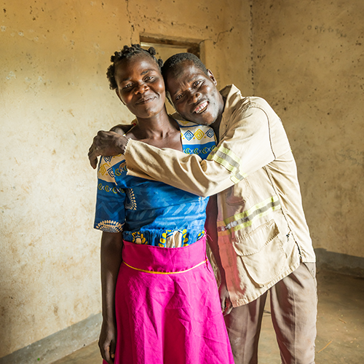
Gospel Acclamation
(Please stand)

Slide 20
Halle, Halle, Halle
Chorus by Marty Haugen

Slide 21
Gospel
A reading from the Gospel of Matthew
Sermon on the Mount
(Mt 5:1-12)
All: Praise to you, Lord Jesus Christ.

Slide 22
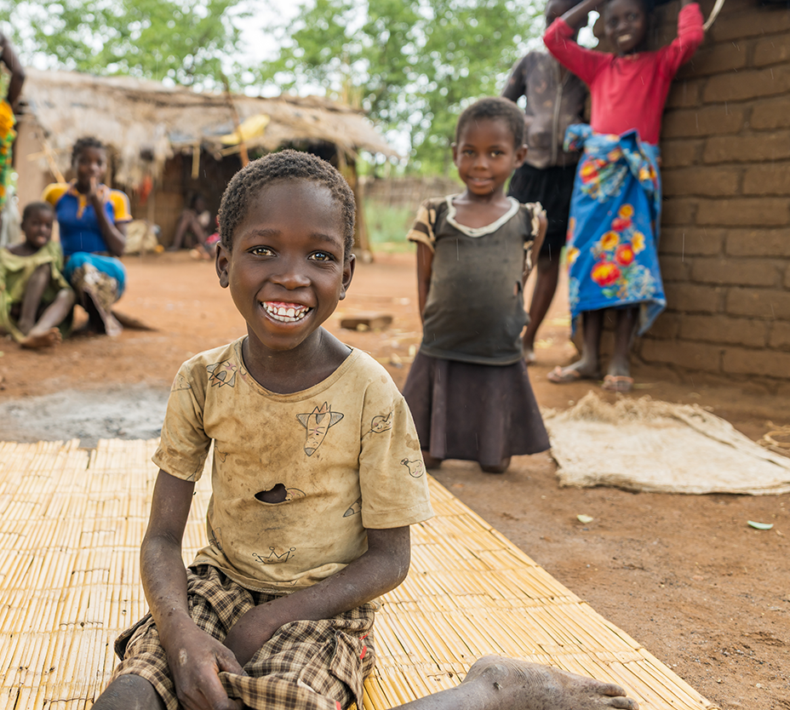
Homily

Slide 23
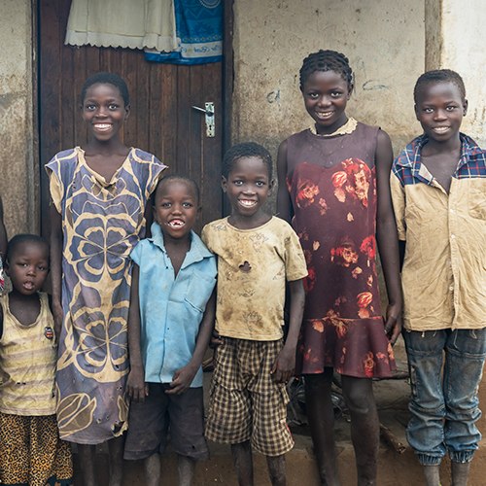
Student Reflection of Gospel

Slide 24
All: Lord Hear Our Prayer
Prayers of Intercession

Slide 25
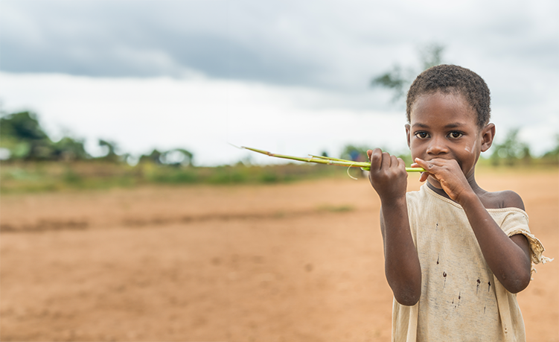
Universal Prayer:
The Our Father

Slide 26
All:
Our Father, who art in heaven, hallowed be thy name; thy kingdom come, thy will be done on earth as it is in heaven.
Give us this day our daily bread,
And forgive us our trespasses, as we forgive those who trespass against us; and lead us not into temptation, but deliver us from evil.

Slide 27
Concluding Rite
All: Amen

Slide 28

Recessional
Hymn
Suggested for Primary Schools:
Hearts on Fire- Michael Mangan
Suggested for High Schools:
Go out, Go Out - Curtis Stephan

